Slide 1
A Better Lee Green & Network for Clean Air
Citizens Science
Pollution Study

Slide 2
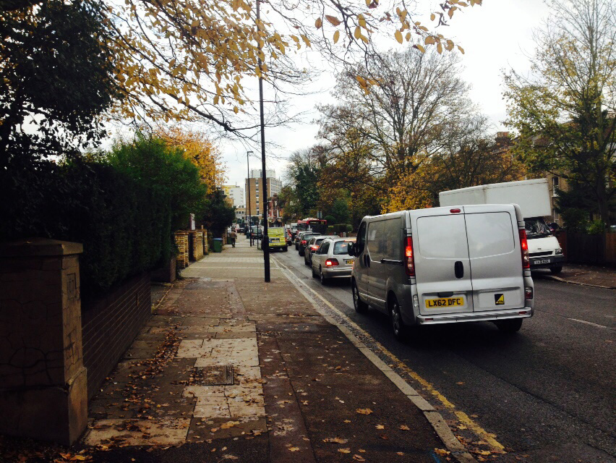
Lee Green, Lewisham, London
Small town centre on junction of A20 and A205 (South Circular) feeder
Frequent congestion

Slide 3
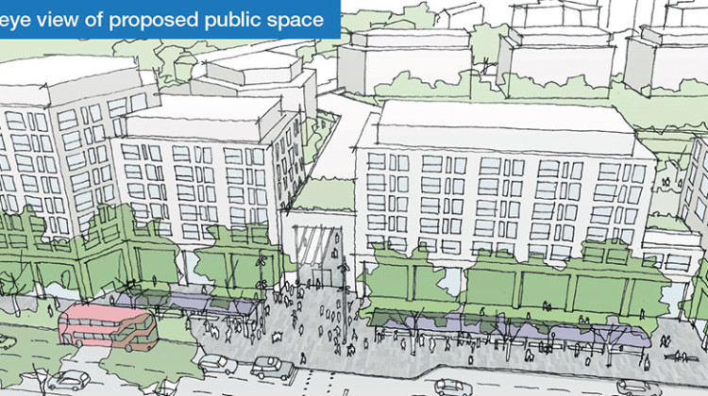
St Modwen plan to build large supermarket on junction, opposite existing supermarket
Will attract around 4000 new cars to junction per day
Local concerns about pollution
Contacted Network for Clean Air, applied for help with community pollution study and they said ‘yes’!

Slide 4
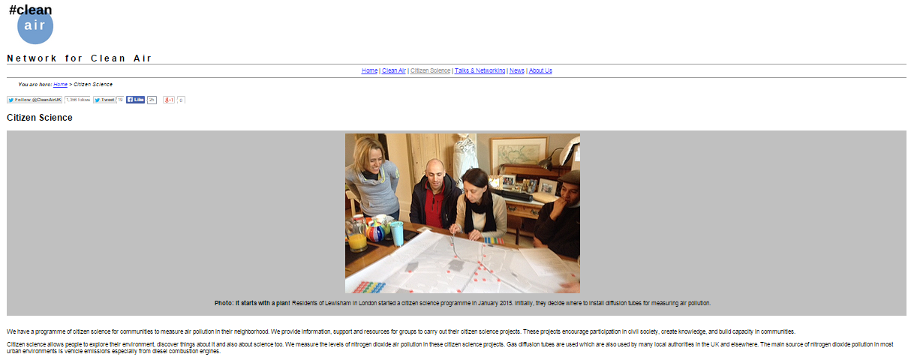
Plotted site where we wanted to hang tubes on a large map
(Junction, schools, churches, parks, surgeries, residential streets, bus stops)

Slide 5
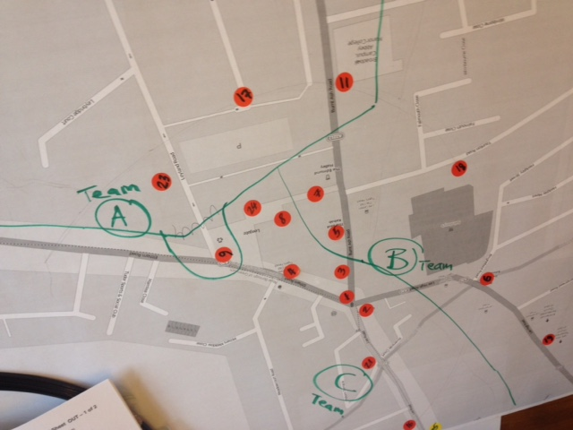
Divided up into three teams
Took on an area each

Slide 6
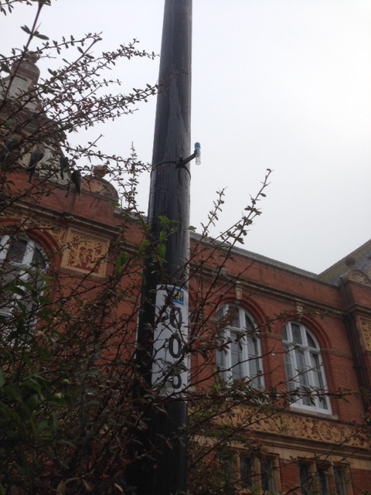
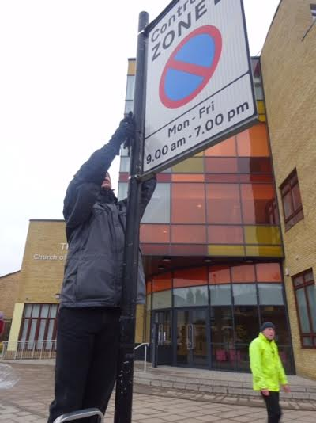
Early one morning set off with ladders, tapes, cameras
Attached
tubes to lamp
posts, road
signs, railings

Slide 7

Put the tubes in the post and wait for the results
Just a few weeks!

Slide 8
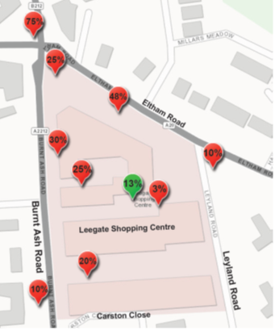
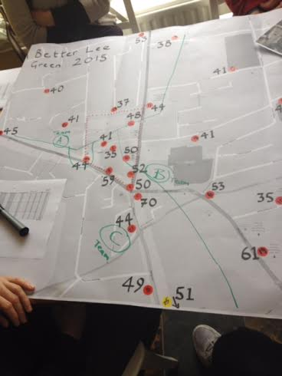
Map the results on the map
Make a clean copy for public release!

Slide 9
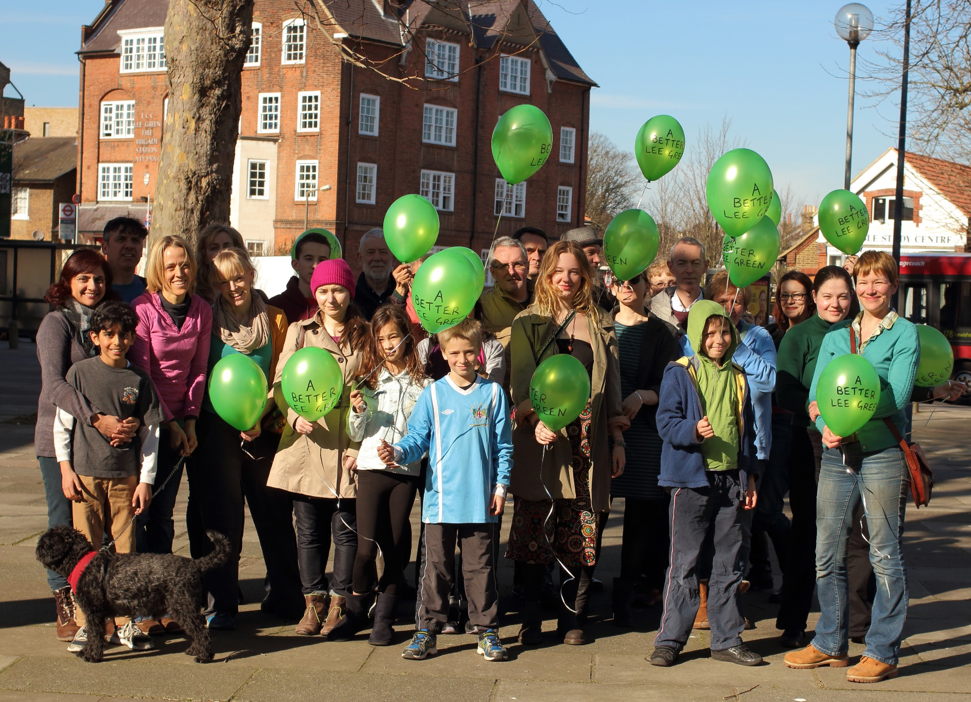
Took a Press Release Photo

Slide 10
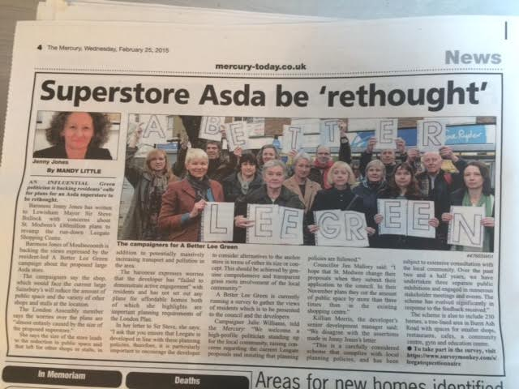
Prepared a press release
Publicised at local events
Contacted local councillors and MPS
Explained what the problem is and what you wanted done (development that attracts less cars and public space away from traffic)

Slide 11
When planning application made by St Modwen, 225 submissions made by the public and local groups:
77% against the plans and many mentioned the high pollutions
What next?
Talking with other local groups who want to measure pollution in their area
Aim to get a complete picture of pollution across Lewisham and raise awareness

