Slide 1


Slide 2


Slide 3
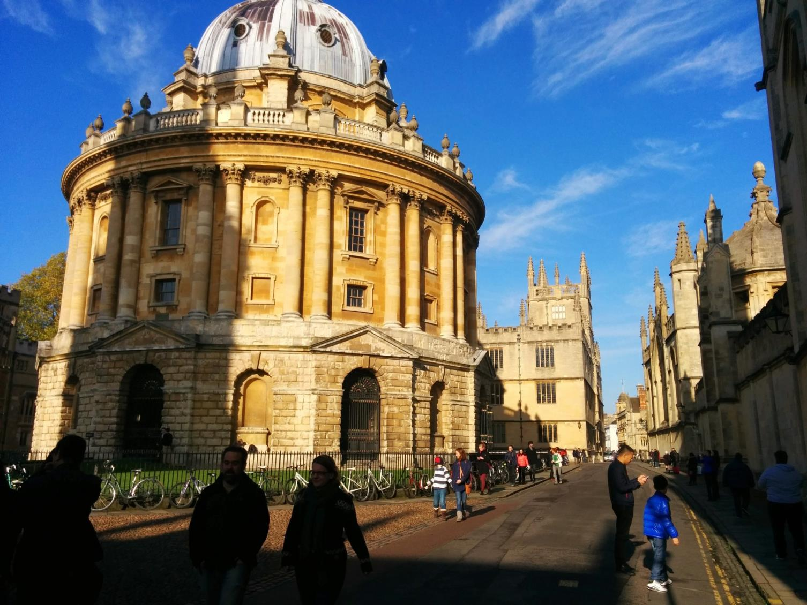

Slide 4
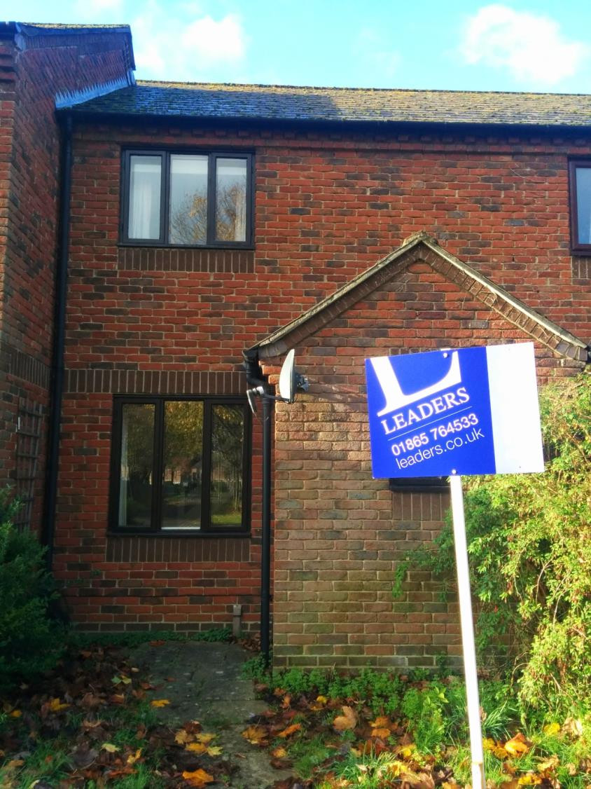

Slide 5
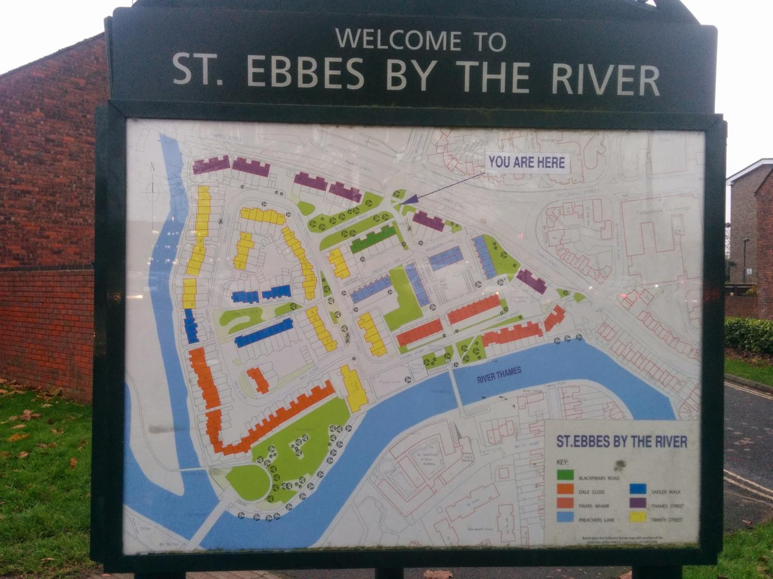

Slide 6


Slide 7


Slide 8
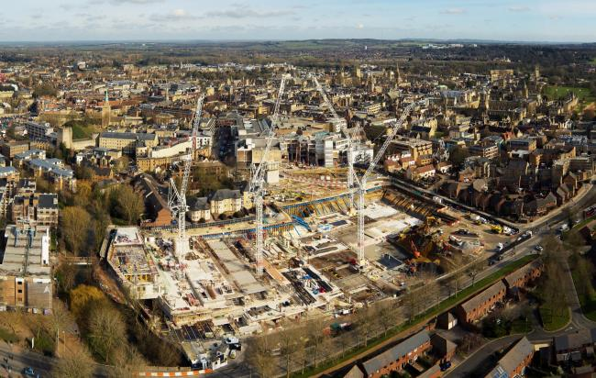

Slide 9
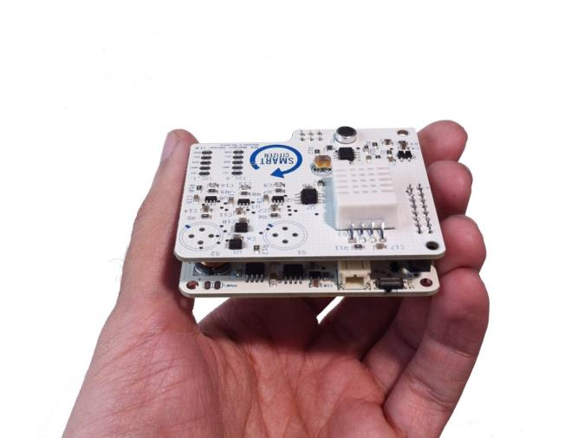
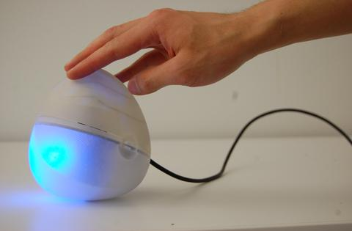
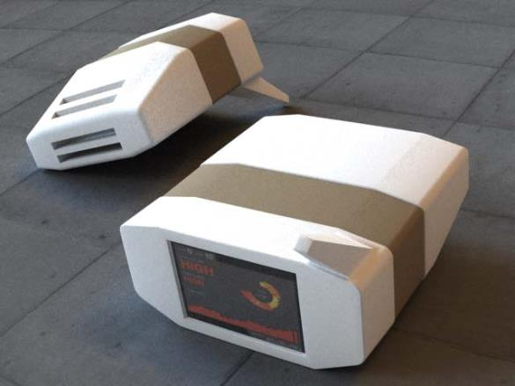
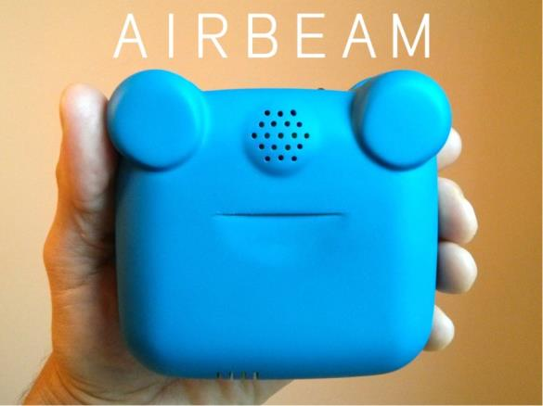
DIY Air Quality Sensors
175 US$
185 US$
200 US$

Slide 10


Slide 11
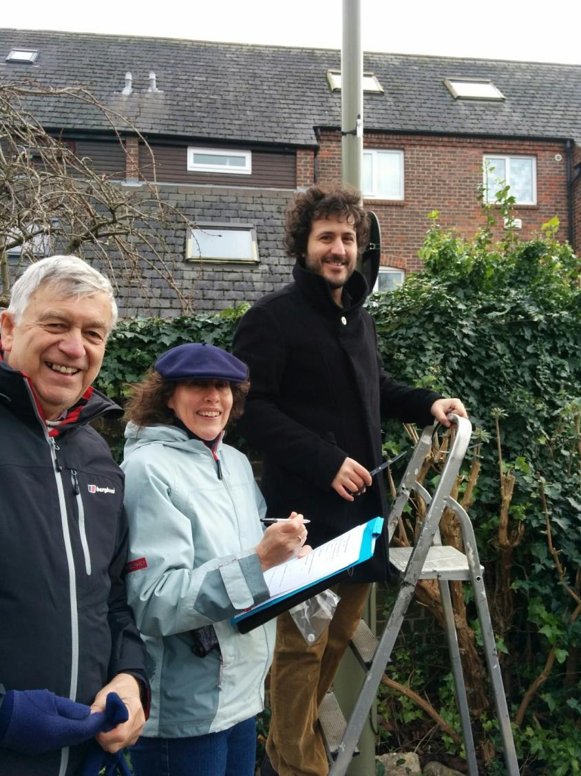

Slide 12
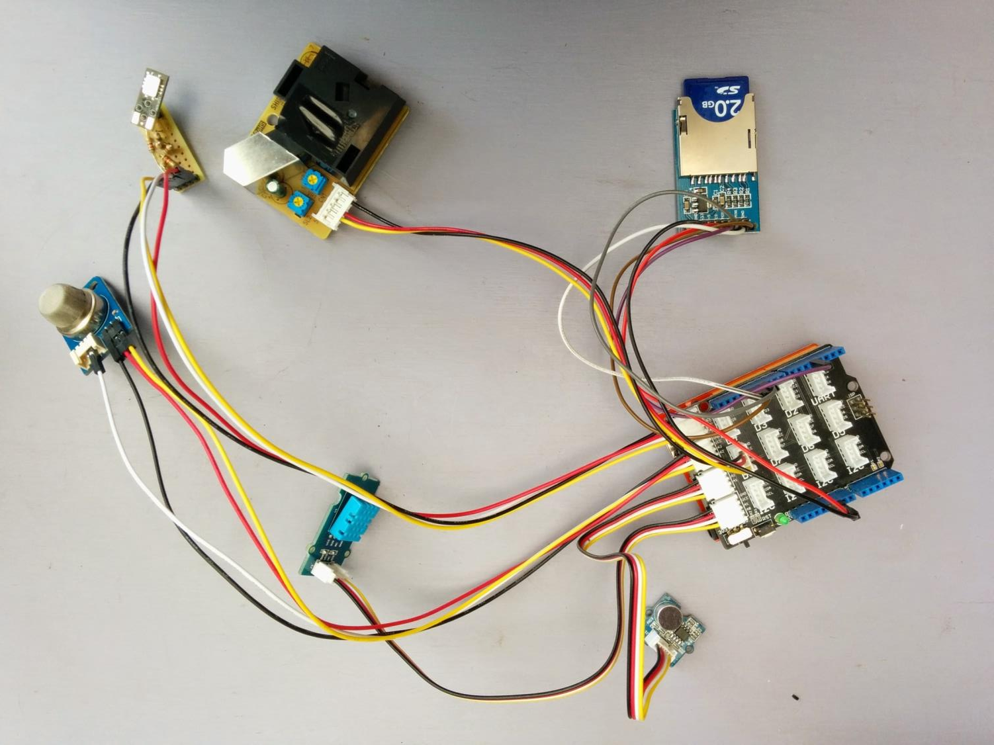

Slide 13
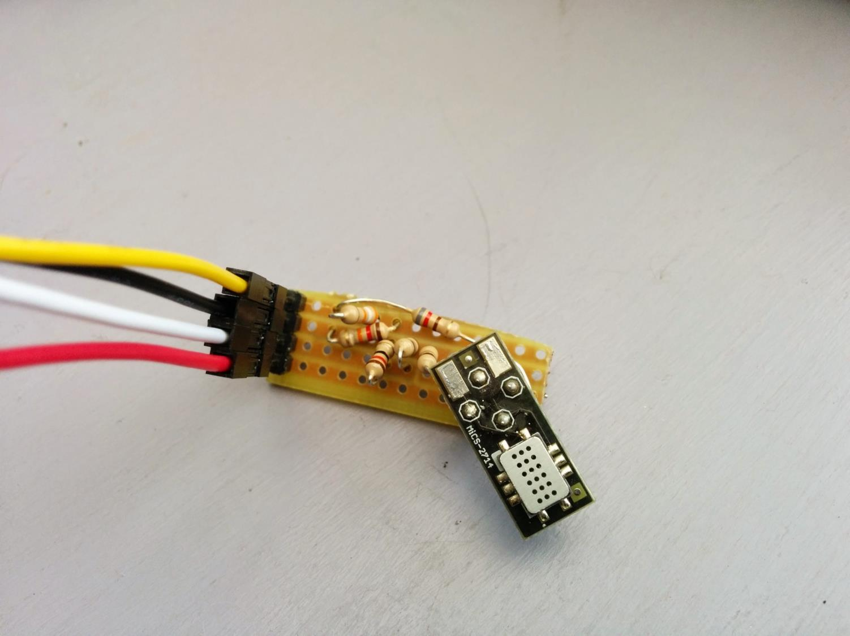

Slide 14
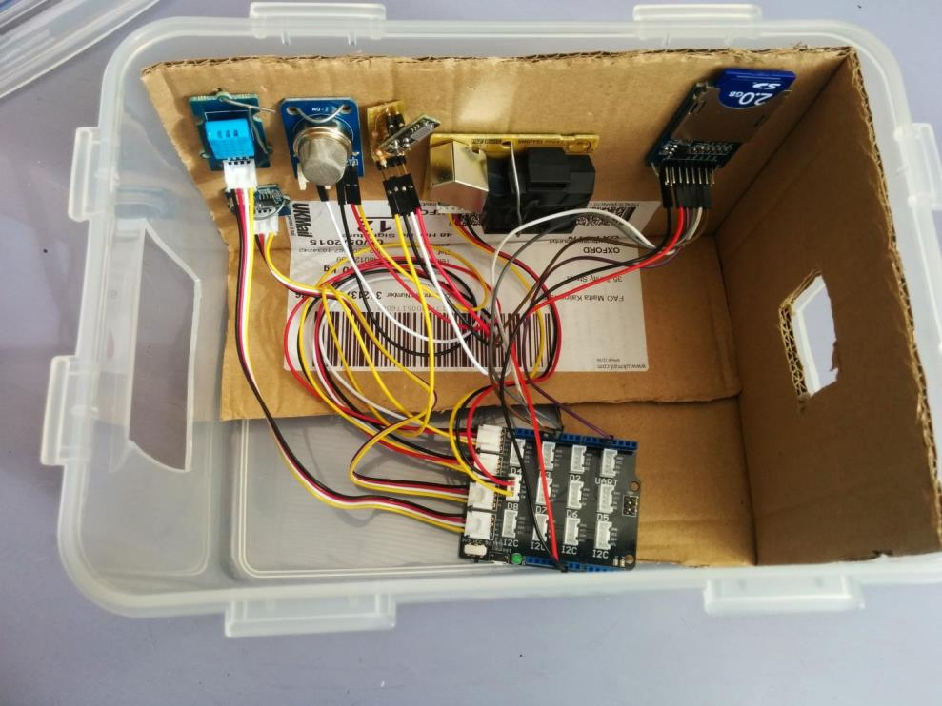
Easy to build
Arduino based
<100 GBP
CO
Particulates
Temp/Hum
SD card
NO2
sound
Arduino

Slide 15
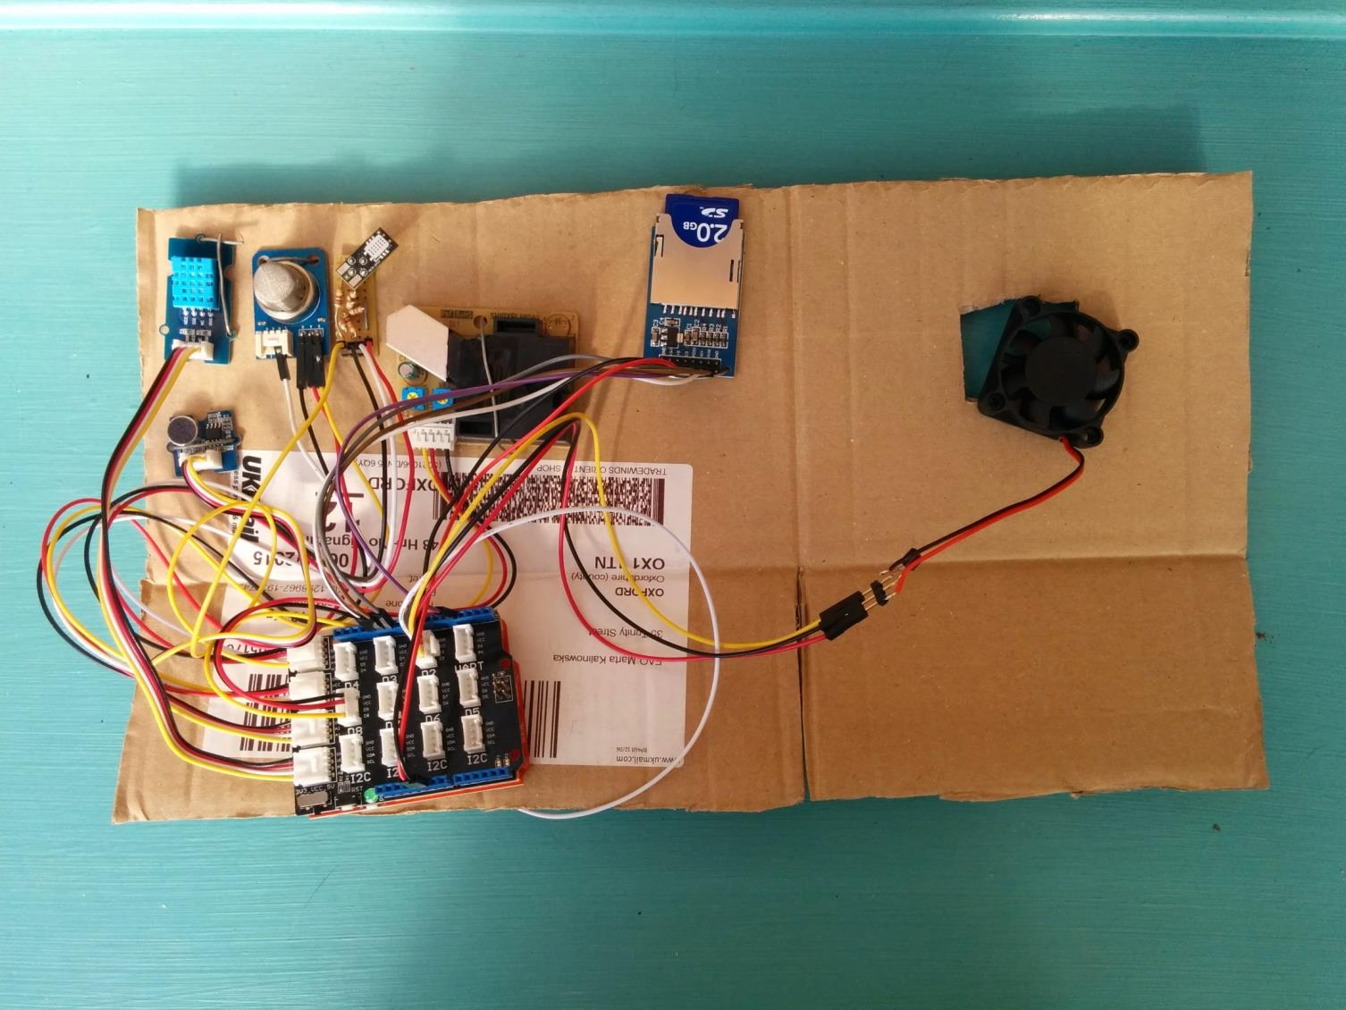

Slide 16
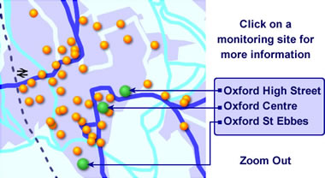
Calibration
In lab:
  Use cylinders of pure gas + reference sensor
  Use pre-mixed cylinders with known concentrations (£100 to £180)
In field:
  Co locate sensor with a deployed sensor
http://www.oxford-airwatch.aeat.co.uk/index.php

Slide 17
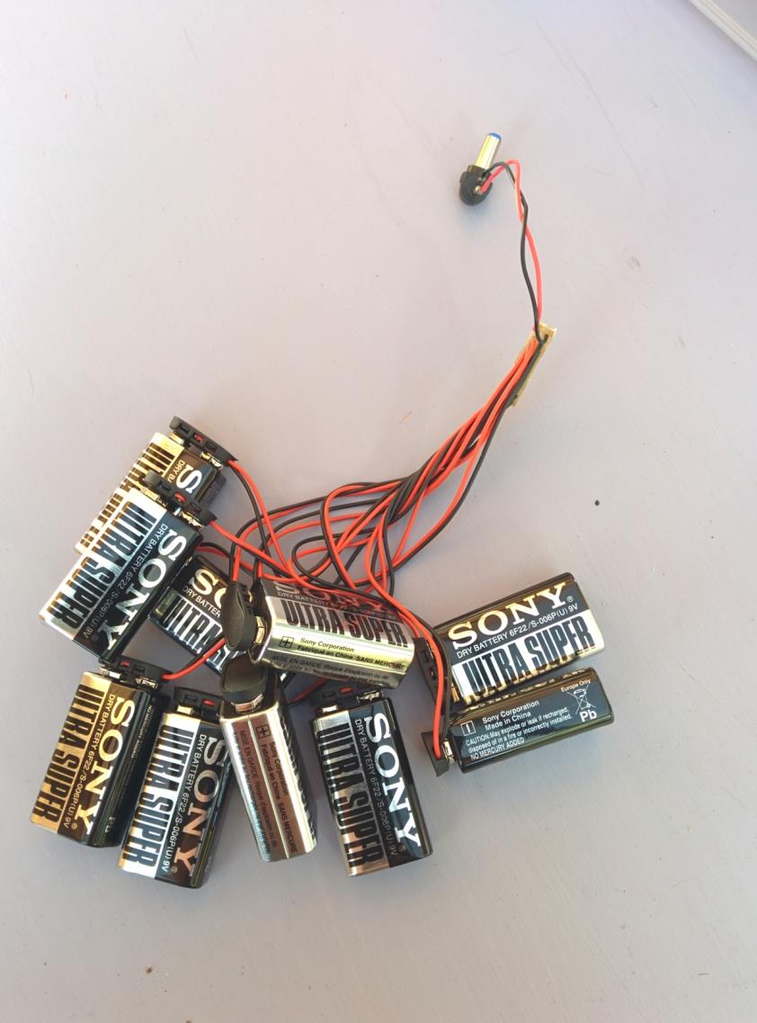

Slide 18
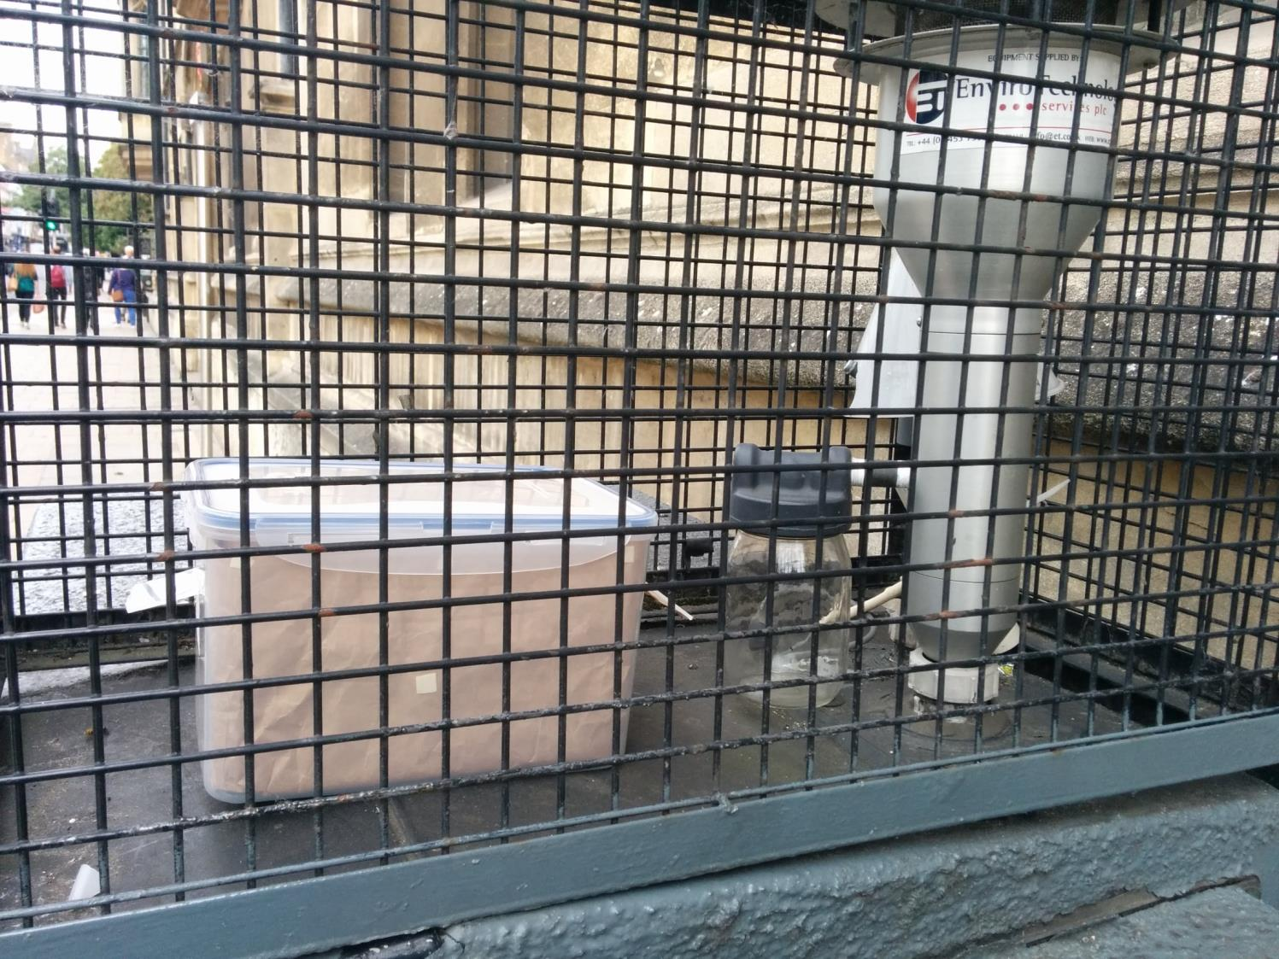

Slide 20
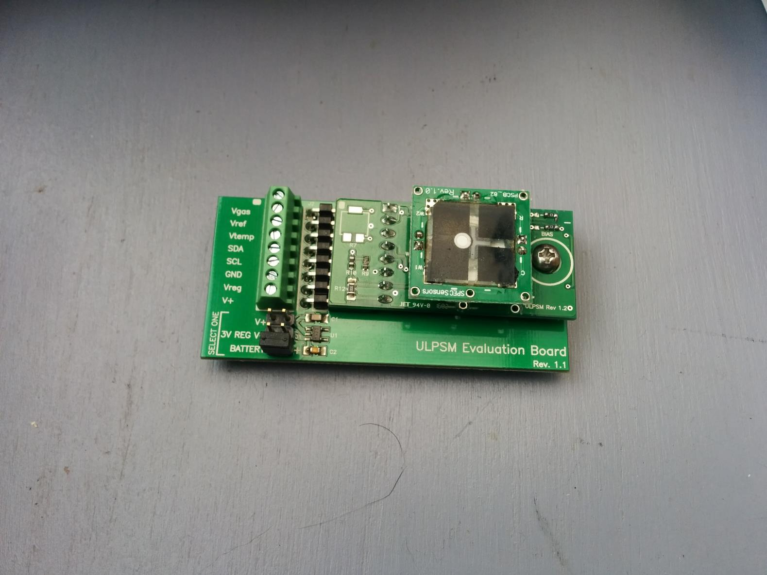

Slide 21
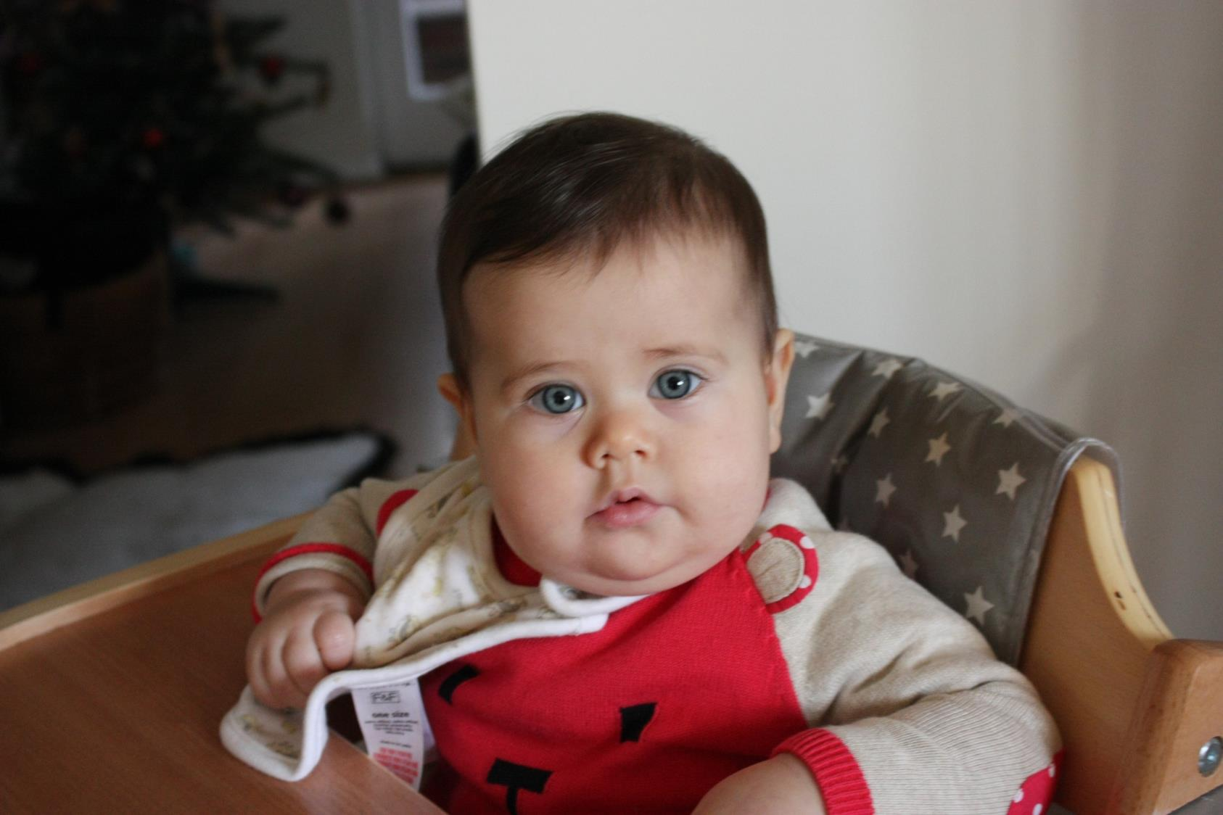

Slide 22

Thanks to
Saint Ebbes New Development Residents Association
Network for Clean Air

Slide 23
Contact
dariosalvi78@gmail.com

