Slide 1
Air Quality Surveys
Charlton and Slade Green – February 2015

Slide 2
National Curriculum for Science –
Notes and guidance (statutory & non-statutory)
Recognise that environments can change and that this can sometimes pose
danger to living things.
Pupils should explore examples of human impact (both positive and negative) on environments ……….. and the negative effects of population and development.

Slide 3
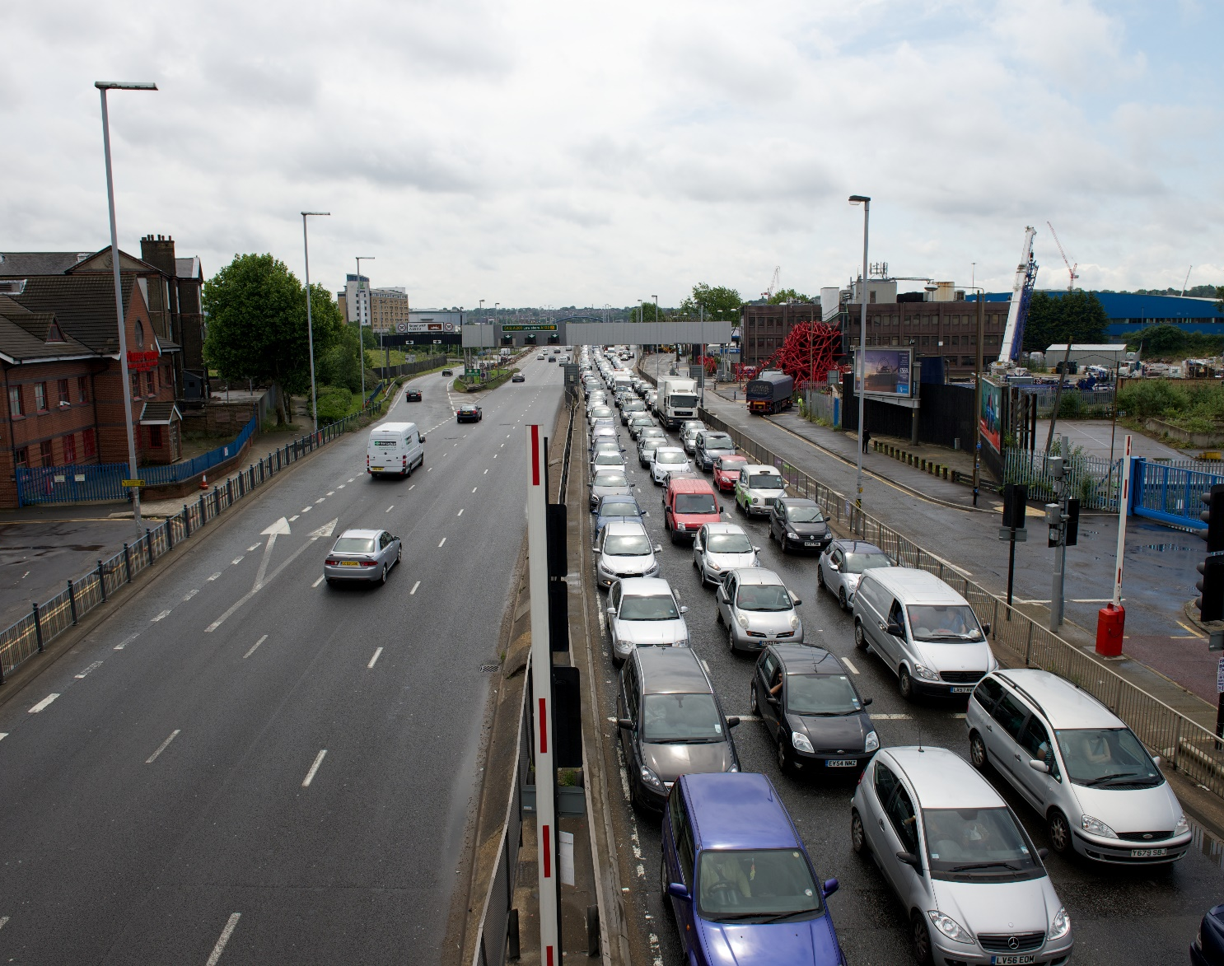
A102
North-bound traffic

Slide 4
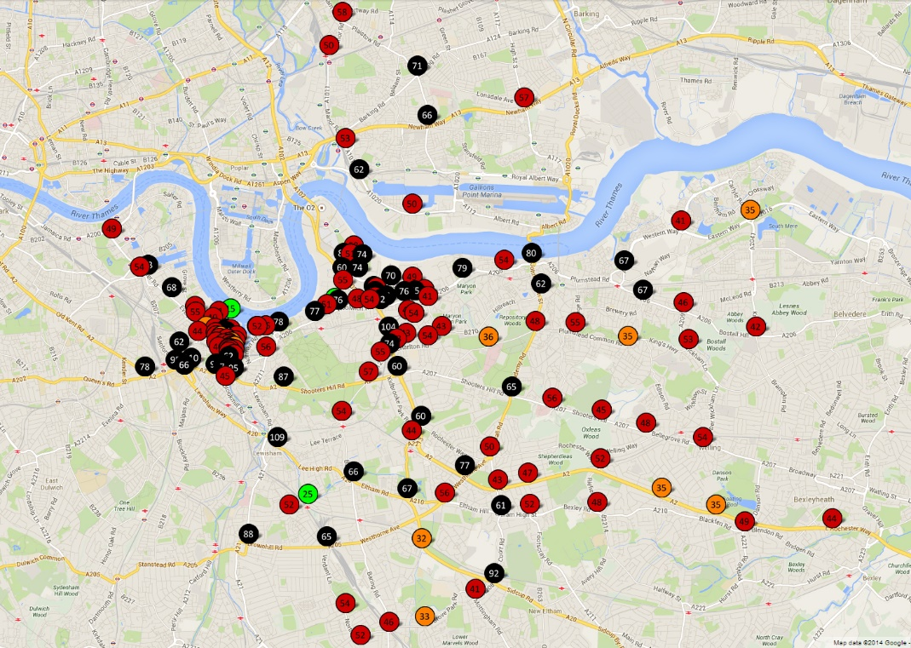
No to Silvertown Tunnel – AQ Survey 2014

Slide 5
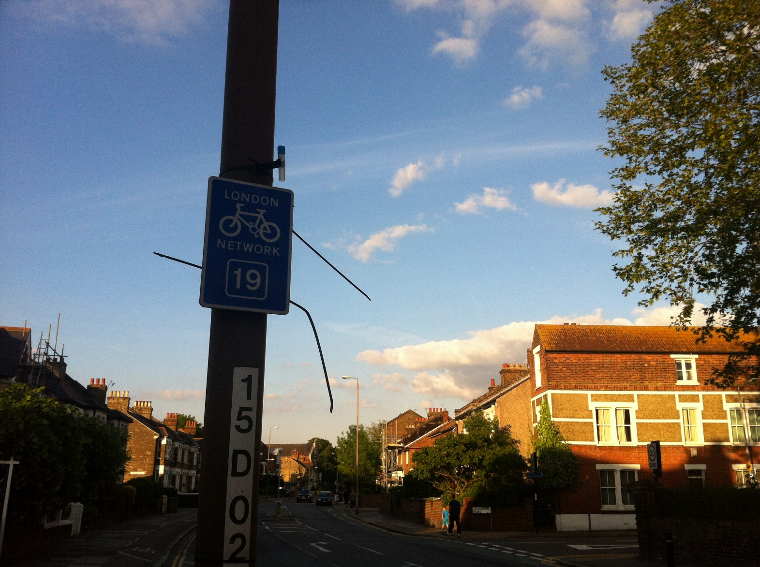
Junction of
Mayhill Road and Charlton Road
Diffusion tube on a lamp post sited approximately 6 feet off the ground.

Slide 7
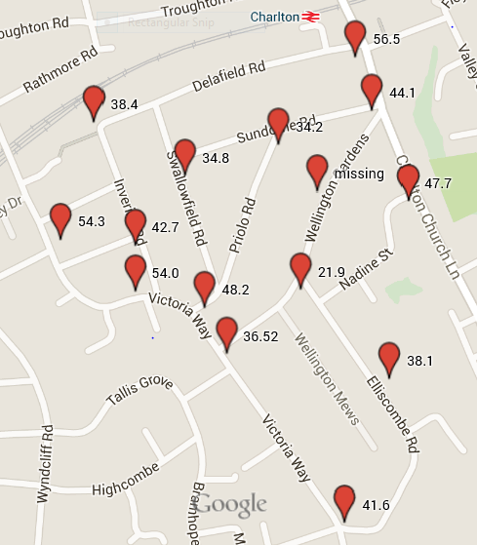
CCRA – Air Quality Survey February 2015

Slide 8
CCRA – fixing the diffusion tube to a lamp post

Slide 9
CCRA – Charlton Church Lane – (47.7ug)

Slide 10
CCRA AQ – Elliscombe Road/ Victoria Way - (41.6 ug)

Slide 11
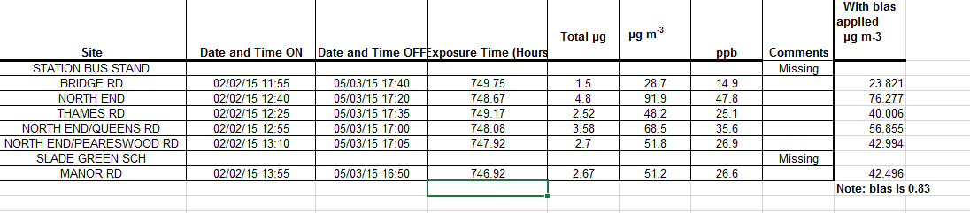
Slade Green Results

Slide 12
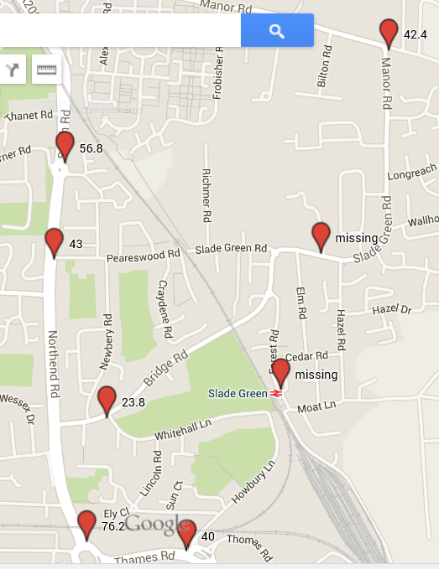
SLADE GREEN AQ SURVEY – February 2015

Slide 13
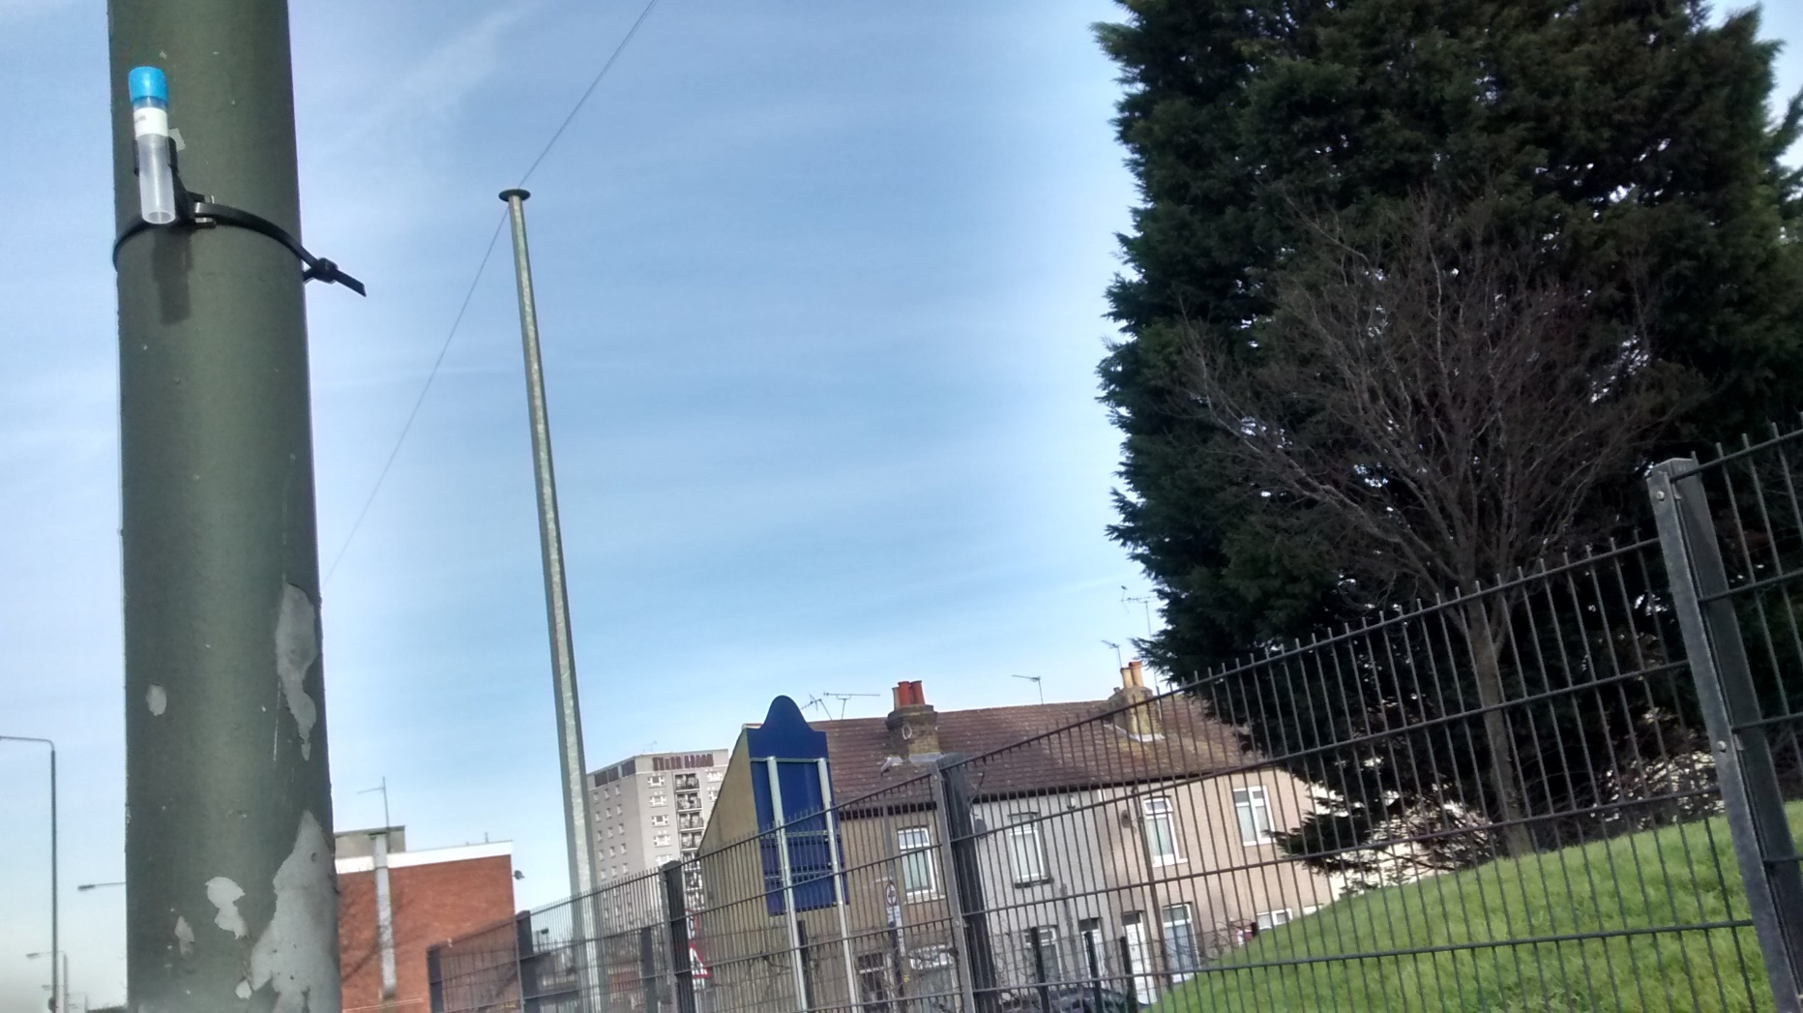
Slade Green – outside Pearswood Nursery School – (43 ug)

Slide 14
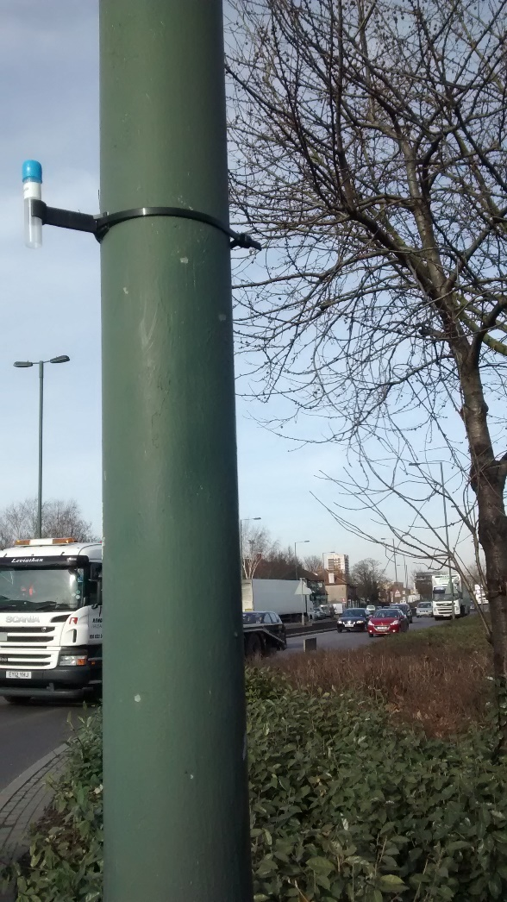
Slade Green – North End (76 ug)

Slide 15
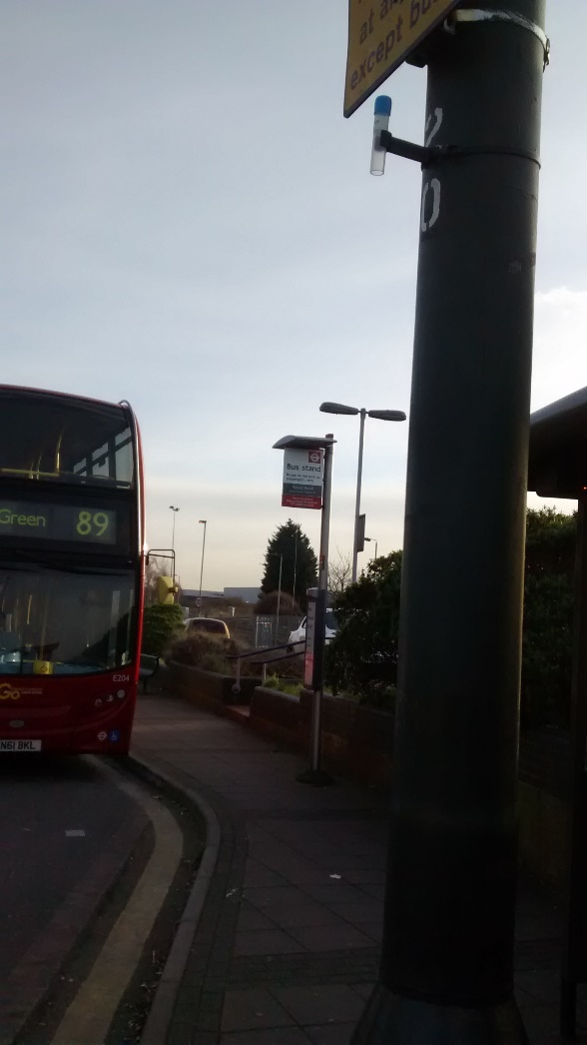
Slade Green Rail Station – before the tube disappeared!

